Slide 1
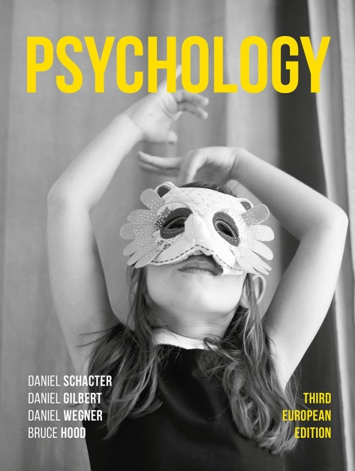
Happiness Hacks
12. Mummy’s little helper

Slide 2
Young children will help others, although the motivation for such altruism remains controversial (Wynn et al., 2018).
With age, however, many of us start to help others even though we will not be guaranteed anything in return.
The motives for adult unconditional altruism are also a matter of debate.
Acts of kindness can have benefits for the one doing the helping, and not necessarily from those who immediately benefit from that help.

Slide 3
Past studies indicate that the link between happiness and prosociality is bidirectional – not only do happy people help others, but helping others also increases one’s own well-being (Dunn et al., 2008; Lyubomirsky et al., 2005b; Weinstein and Ryan, 2010).

Slide 4
Are you getting giving five-a-day?
Sonja Lyubomirsky, a leading expert in positive psychology, has advocated encouraging individuals to perform random and novel acts of kindness as a way to boost happiness.
She and her colleagues have found that undertaking five acts of kindness per day will result in higher levels of well-being than doing one act per day for a week (Lyubomirsky et al., 2005b).

Slide 5
These acts should be:
Novel
Unconditional
Directed at different recipients

Slide 6
Why not give it a try?
If you can maintain your five daily acts of kindness (think of it like your five-a-day fruit and veg target), you should feel happier.

Slide 7
‘true happiness comes from making others happy’
- Hindu proverb

