Slide 1
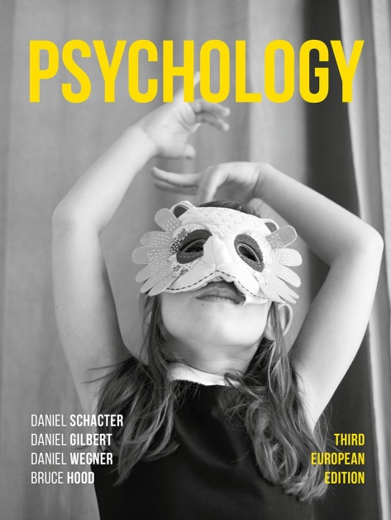
Happiness Hacks
14. Buy yourself some happiness – by spending on others

Slide 2
The trouble with buying things for ourselves…
We easily habituate to the things we buy for pleasure.
The process of hedonic adaptation means that we are constantly wishing for more such things to buy, in the vain hope that each thing will make us happy.

Slide 3
What if we are just spending money on the wrong person?
Elizabeth Dunn and her colleagues (2008) asked over 600 US adults about their salaries, gifts they had bought for themselves and others, and finally, the donations they made to charity.
They found that personal spending was unrelated to happiness but that spending on others was associated with greater levels of happiness.
This was a correlational analysis, so the researchers tested the relationship between happiness and spending money on others in an experimental study (Dunn et al., 2008)

Slide 4
The experiment
Dunn and her colleagues gave 46 adult Canadians a test of happiness in the morning and then handed them an envelope that contained either $5 or $20, with the instructions that the money had to be spent by the end of the day on either themselves (selfish group) or someone else (prosocial group).
At the end of the day, they found that happiness levels were significantly higher in the prosocial group compared to the selfish group, taking into consideration their individual scores in the morning, irrespective of the amount they spent.

Slide 5
Reflecting upon the findings
Canadians are famously agreeable, and this was a relatively small study.
It could be that these were WEIRD findings, limited to rich Westerners for whom $5 or $20 is not much of a sacrifice.
Maybe the finding was a fluke?

Slide 6
HOWEVER, when the study was repeated across different countries, the researchers found the same effect of prosocial spending and increased happiness (Aknin et al., 2014).

Slide 7
Why not give it a try?
If you are a typical student then you may be struggling financially, and not in a position to spend much money on others.
Yet for the price of a coffee every once in a while, you may be investing in your own happiness – something money does not normally buy.

