Slide 1
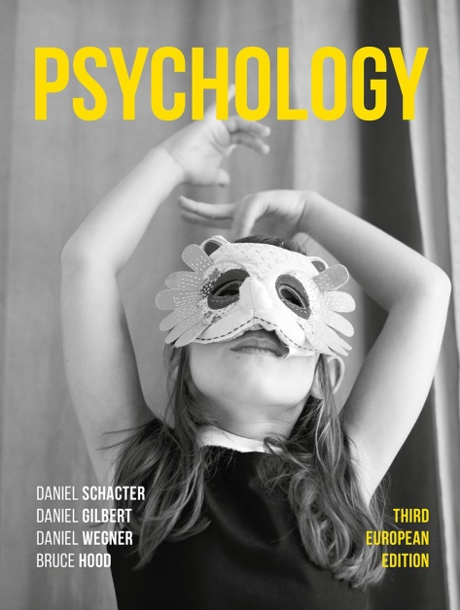
Happiness Hacks
3. The neuroscience of giving

Slide 2
Imagine you were given £5…
Would it bring you greater happiness to spend it on yourself, or on someone else?

Slide 3
In a seminal paper written by Liz Dunn and her colleagues, published in Science….
Participants were rated on their levels of happiness in the morning and then given an envelope containing either $5 or $20.
They were instructed either to spend it on themselves or on another person the very same day.
They were asked to predict how happy they would be spending money on themselves or others .

Slide 4
The results?
Participants who spent their money on someone else – irrespective of the amount – showed greater increased happiness than those who spent it on themselves.
The pattern was the opposite of their predictions – which had been that people would be happier spending on themselves.

Slide 5
Not just WEIRD results…
Cross-cultural studies have shown the same relationship between acts of generosity and personal happiness in 136 countries – even in poor societies, individuals feel better after giving to others than after spending on themselves (Aknin et al., 2014).

Slide 6
What’s the neuroscience behind all of this?
Generosity and other-regarding behaviour has been shown to be associated with activity in the temporal parietal junction (TPJ) (Carter et al., 2012; Morishima et al., 2012; Strombach et al., 2015).
Happiness is associated with coactivation in the so-called ‘reward’ and ‘pleasure’ centres of the ventral striatum (Vs) and orbitofrontal cortex (OFC) (Rutledge et al., 2014, 2015).

Slide 7
In a recent study by Park et al (2017)…
The positive emotional experience of giving (the ‘warm glow’) was investigated using fMRI.
Participants were given CHF25 (about £20) each week for a month, and asked either to spend their money on others (experimental group) or on themselves (control group).

Slide 8
After a month, all participants performed an independent decision-making task to contribute money to others, in which they could behave more or less generously. Brain activity was measured using fMRI.
Participants in the experimental group made e generous choices in the decision-making task and showed stronger increases in self-reported happiness compared to participants in the control condition (Park et al., 2017).

Slide 9
Generous decisions engaged the TPJ in the experimental group more than in the control group and differentially modulated the connectivity between TPJ and Vs.
VS activity during generous decisions was directly related to changes in happiness.

Slide 10
Feeling like your happiness levels could do with a boost?
Buy someone a cup of coffee, and enjoy the warm glow that should follow!

Slide 11
‘When I do good, I feel good. When I do bad, I feel bad. That’s my religion’
Abraham Lincoln

